Slide 1
Code Quality Handbook Presentation By Talha Mahmood

Slide 2

Chapter 1 Documentation
Code documentation best practices

Slide 3

Help People Understand
Minimize Time Investment
Informative Comments
Understandable
Unexpected Behavior
Notes:
Good documentation should:
Time Investment: Minimize understanding time.
Informative Comments: Comments provide information and value but avoid excessive comments.
Understandability: Focus on clarity over conciseness for better understanding.
Unexpected Behavior: Document unusual behavior or edge cases.

Slide 4

Make it Look Good
Consistency and Alignment
Blank Lines
Order
Notes:
Consistency and Alignment: Use consistent spacing, indentation, and alignment.
Blank Lines: Break up large code blocks with blank lines.
Order: Maintain a consistent order for variables and elements.

Slide 5

Breaking Down Big Blocks
Break down large functions
Focus on one task per function
Write concise code
Leverage standard libraries
Notes:
Break down large functions: This improves code readability, testability, and maintainability.
Focus on one task per function: This makes code easier to understand and maintain.
Write concise code: Avoid unnecessary features and complexity.
Leverage standard libraries: Familiarize yourself with existing functions and tools.

Slide 6
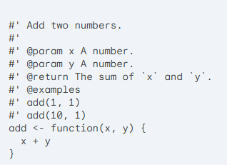
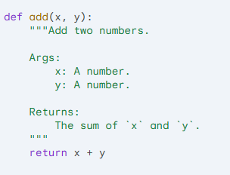
Document Outside Functions
Whole Function Documentation
Example in R and Python
Notes:
Whole Function Documentation: Document what your function is doing and document it as a whole and not the individual parts of the function.
Example in R and Python

Slide 7
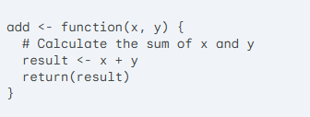
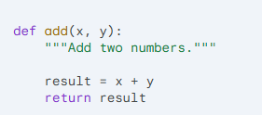
Document Inside Functions
Individual parts documentation
Example in R and Python

Slide 8

Chapter 2 Git and Version Control Best Practices
Git best practices.
What is Git ?
Notes:
Git is a version control system essential for collaborative development.

Slide 9

Commit Related Changes
Unrelated Changes
Detailed Control
Notes:
Unrelated Changes: Avoid combining unrelated changes in a single commit.
Detailed Control: Git's staging area allows for detailed control over commits so you can also commit specific parts not whole code

Slide 10

Commit Often
Small commits
Frequent Code Sharing
Reduces Merge Conflicts
Notes:
Small commits: Keeps commits small and focused.
Frequent Code Sharing: Enables more frequent code sharing.
Reduces Merge Conflicts: Reduces merge conflicts and improves collaboration.

Slide 11

Don’t Commit Half-Done Work
Complete code
Small Manageable Chunks
Stash
Notes:
Complete code: Commit only completed code.
Small Manageable Chunks: Break down features into smaller, manageable chunks.
Stash: if we want to save unfinished work temporarily we can use Git's "stash" feature

Slide 12

Test Before You Commit
Functional
Side effects
Careful in sharing
Notes:
Functional: Ensure code is complete and functional.
Side effects: Check for unintended side effects.
Careful in sharing: Thorough testing is especially important when sharing code with others.

Slide 13

Write Good Commit Messages
Concise summary
Motivation
Link to tasks ( if using management tool)
Categories (feat, fix, chore, doc, build)
Example:
Summary : feat: Add new feature to support Kerberos
Detail: This feature enables Kerberos authentication for JupyterHub.
Notes:
Concise summary: Start with a concise summary (50 characters or less).
Motivation: Explain the motivation and changes made.
Link to tasks: Link commits to tasks iif using a management tool.
Categories: Use categories (e.g., feat, fix, chore, doc, build) for filtering.
feat: feature implementation, fix: bugfix, chore: small change, doc: documentation change, build: build related change

Slide 14

Version Control is Not a Backup System
Primary purpose
Semantic commits
Notes:
Primary purpose
Git tracks changes and facilitates collaboration.
Semantic commits
Focus on committing related changes, not just saving files.

Slide 15
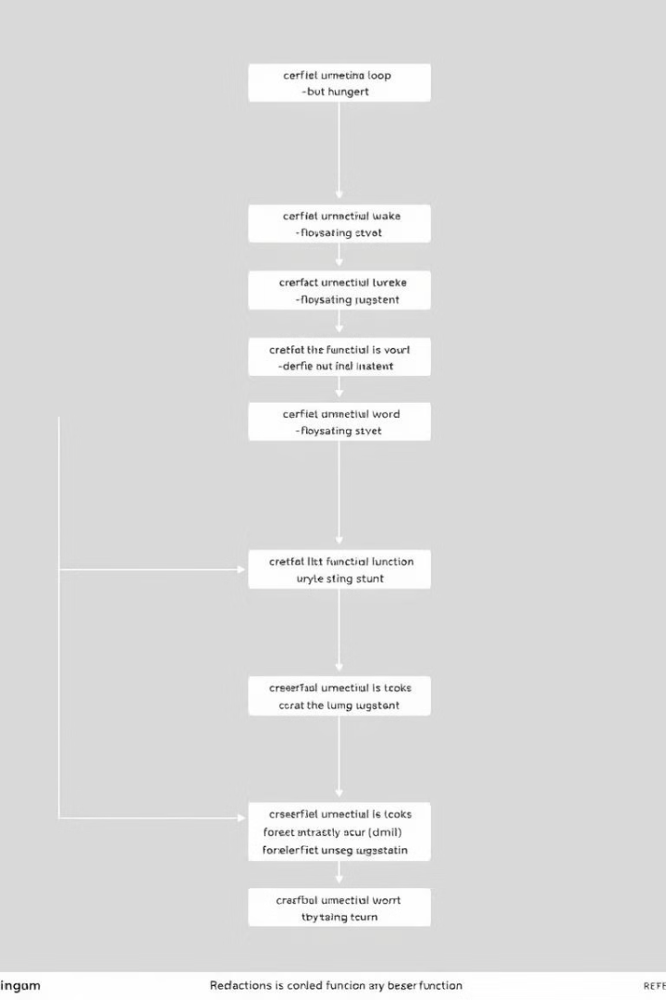
Use Branches
1
Power of branches
2
Isolation
3
Use cases
.
Notes:
Power of branches: Git makes branching easy and efficient.
Isolation: It avoid mixing different development lines
Use cases Branches are ideal for features implementation and bug fixes.

Slide 16
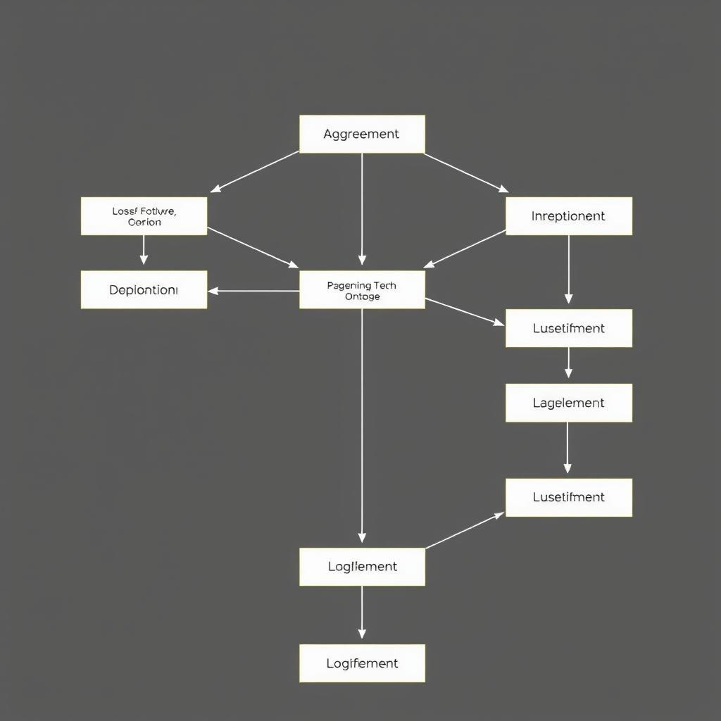
Agree on a Workflow
Options
Factors
Agreement
Notes:
Options: Git offers various workflows (long-running branches, topic branches, merge/rebase, Git-flow).
Factors Consider project size, development practices, and team preferences factors.
Agreement Ensure everyone follows a same workflow.

Slide 17

Recommended Git Flow
Create a new branch
Commit changes
Test and finalize
Push to remote
Notes:
Create a new branch: Branch out from the main branch.
Commit changes: Commit your code to the new branch.
Test and finalize:
Resolve any conflicts.
Merge your branch into the main branch (squashing commits).
Push to remote: Push the updated main branch to the remote repository.

Slide 18
Thanks

